Slide 1
Chapter 2

Slide 2
Objectives

Slide 3
Objectives (cont.)

Slide 4
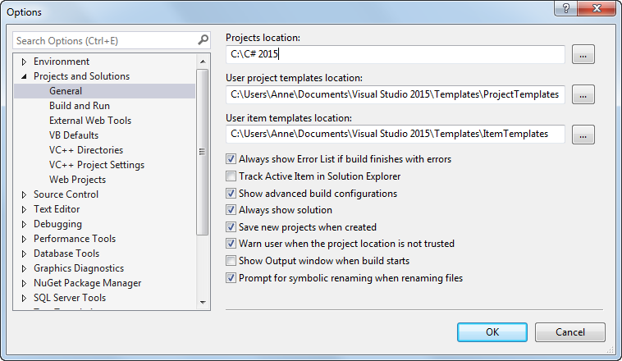
The Options dialog box for setting the project options

Slide 5
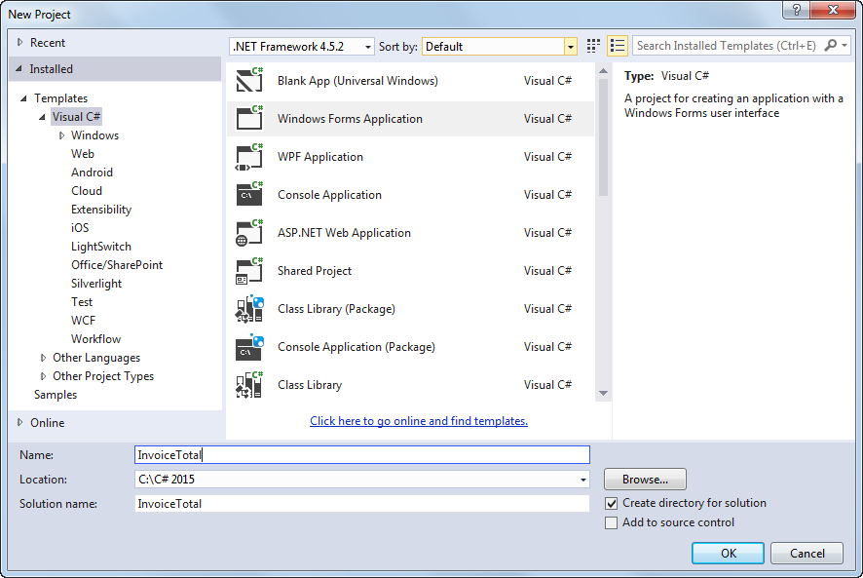
The New Project dialog box

Slide 6
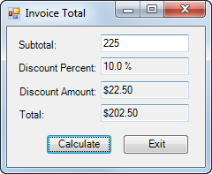
The Invoice Total form

Slide 7
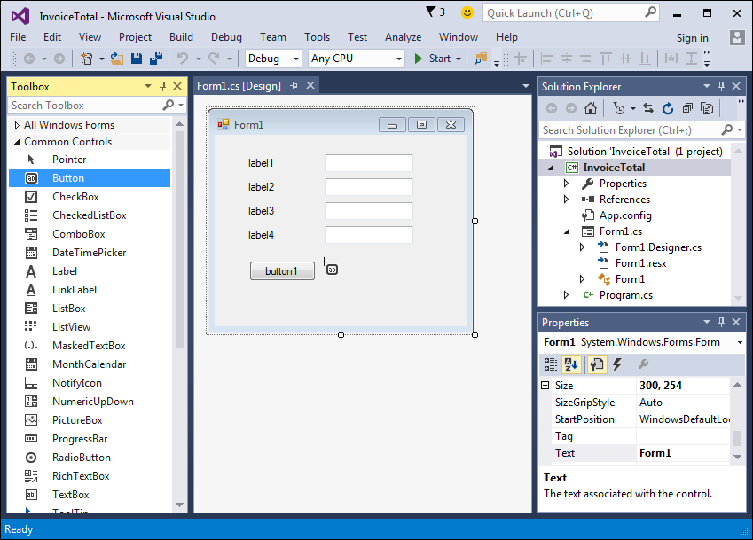
A form after some controls have been added to it

Slide 8
Three ways to add a control to a form

Slide 9
How to select and work with controls

Slide 10
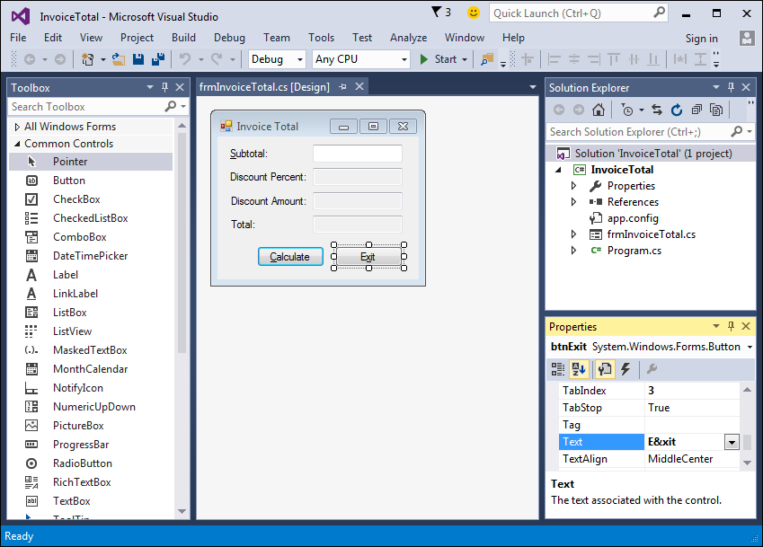
A form after the properties have been set

Slide 11
The Name property

Slide 12
The Text property

Slide 13
Other properties for forms

Slide 14
Other properties for controls

Slide 15
How to adjust the tab order

Slide 16
How to set access keys

Slide 17
How to set the Enter and Esc keys

Slide 18
The property settings for the Invoice Total form

Slide 19
The property settings for the controls

Slide 20
The property settings for the controls (cont.)

Slide 21
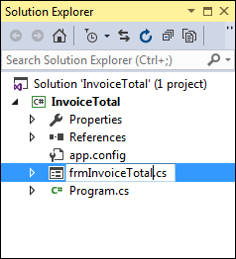
The Solution Explorer as a form file is being renamed

Slide 22
How to rename a file, project, or solution

Slide 23
How to save a file, project, or solution

